Slide 1
Strings, Part 2

Slide 2
Strings are Immutable
Immutable means unchangeable. Once you have a string, you can’t change it - you have to remake it.
This is why you have to set all the string methods equal, like this: string = string.lower() instead of just calling string.lower()
The string methods don’t modify your original string - they return a new string.

Slide 3
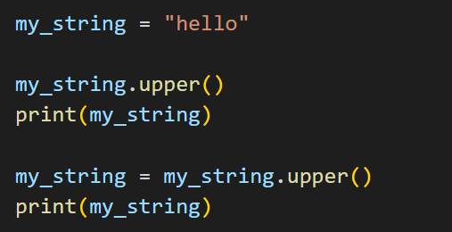
Exercise - Immutability
What is the output when you run this code?

Slide 4
Indexing
Indexing is how we access an individual thing inside a group.
We use square brackets [] after the variable name to denote indexing.
Indexes start at 0 and go to the length of the object minus 1.
So if our string is ‘hello’ we would go from 0-4
mystr = "hello"
mystr[0] is "h"
mystr[4] is "o", the same as mystr[len(mystr)-1]

Slide 5
Indexing in Reverse
You can use a negative number to start at the end of the string
-1 is the last index of a string, the same as len(string)-1
mystr = "hello"
mystr[-1] is "o"
mystr[-4] is "e"

Slide 6
Slicing
We can pull sections of our object using slicing.
Instead of indexing using 1 number we instead use 2 or 3 numbers.
If we use 2 numbers it goes [start:stop]
This includes start, but excludes stop (goes to one before stop)
If we use 3 numbers it goes [start:stop:step]
mystr = 'ILikeApples'
mystr[1:5] is 'Like'
mystr[0:len(mystr):3] would be 'IKpe', same as mystr[::3]

Slide 7
Slicing in Reverse
You can also use reverse indexes when slicing.
You can use a negative number as your start, stop, or step.
To get a string backwards, you can leave start and stop blank:
mystr = "hello"
mystr[::-1] is "olleh"

Slide 8
Exercise
Write some code to print the second half of a string.
(If the string is odd length, you can choose whether to print the shorter or longer "half")
Example:
python
hon

Slide 9
Exercise - Valid Email
Write some code that takes input from the user and prints whether it’s a valid email address. Make sure to sanitize the user input with .strip()
An email address is valid if:
It has a "." at the third-to-last index
It has exactly one "@" symbol, at the fifth-to-last index or earlier
There is at least one character before the "@" symbol
It doesn’t have any spaces (doesn’t contain " ")
If all these conditions are met, print True. Otherwise, print False.
To do this, use boolean statements on your string.
Test your code on a few inputs to make sure it works!

Slide 10
Ascii and Escape Characters
By default, python strings use ASCII characters.
We can denote special characters using a backslash.
This is called an escape character.
Different combinations mean different things (see next slide).
There are ways to use different character sets like UTF-8, that support more characters like emojis and other languages.

Slide 11
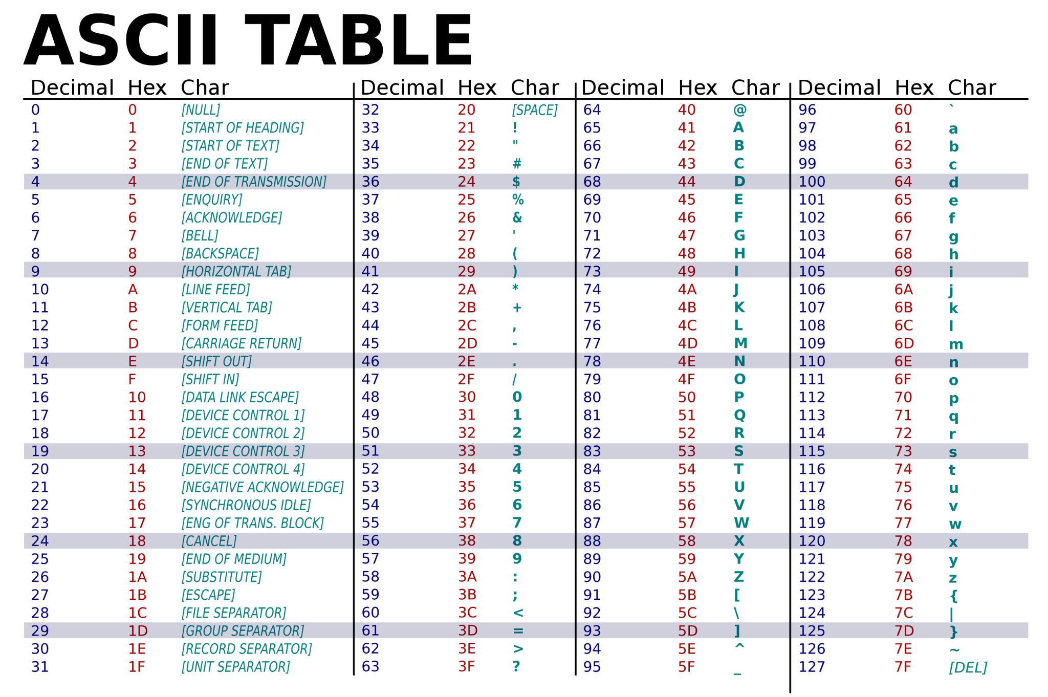

Slide 12
Escape Characters
Most common escape chars:
\' Single Quote
\" Double Quote
\\ Backslash
\n New Line
\t Tab
Other escape chars:
\r Carriage Return
\b Backspace
\f Form Feed
\ooo Octal value
\xhh Hex value
Each of these only counts as one character when you’re indexing a string or taking the length of a string, even though it looks like more than one

Slide 13
Print Formatting
By default, the print function takes a string, or multiple items separated by commas, and ends with a new line.
What if you want to have more control and customization?
You can choose to end the print statement with a different character, separate by a different character if you’re using commas, or format your print statement in different ways

Slide 14
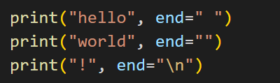
end=
By default, print statements end in a new line, or "\n"
If you want to end with a different character, use the end= keyword, and put whatever character you want after the equals.
The default is end="\n"
Exercise: What is the output of this code?

Slide 15

sep=
By default, if you print multiple values separated by commas, they will be separated by spaces
The sep= keyword lets you choose a different character to separate them.
The default is sep=" "
Exercise: What is the output of this code?

Slide 16
Exercise - sep and end
Get input from the user and store it in a variable called userin.
Then print the user input. The output should follow exactly this format, including the colon and period at the end:
You entered: userin.
Where userin is what you got from the user.
You must format the print statement like this:
print("You entered",userin)
How can you add sep and end keywords to get the exact formatting shown above?

Slide 17
Formatting with .format()
Print formatting is a more streamlined way to print variables within strings than using commas or concatenation.
Print a string, and anywhere you want to place a variable, put curly brackets {}. Then call .format() on the string and pass in the variable names to substitute for the brackets.
You can also specify more within the brackets such as naming each placement, data type, number of decimals in a float, etc.

Slide 18

Formatting with f-strings
A newer version of print formatting added in Python 3.6, and a better alternative to using .format()
Put f before your string, and in curly brackets you can directly put the names of any variables you want to print.
Optionally, you can put a colon after the variable name and then add a data type specifier like .2f (print a float to two decimal places).
This is our number: 12.46

Slide 19
Exercise - Print Formatting
You need to write a script that will generate an email to a customer who has just made a purchase. You have 3 variables:
name, which stores the customer’s name as a string
product, which stores the product name as a string
price, which stores the price of the product as a float
Use an f-string to generate an email message with the following text, and print it. Make sure to round the price to 2 decimal places. The email should be one multi-line string.
Dear {name},
Thank you for your purchase of a {product}. Your credit card has been charged ${price}.
We appreciate your business and look forward to serving you again.
Sincerely,
The ABC Company

Slide 20
Home Practice
Write some code that takes a string and tells if it is a palindrome (same forwards and backwards).
Hint: Use indexing/slicing and boolean expressions
Examples:
racecar: True
cat: False

Slide 21
Resources
Strings:
https://docs.python.org/3/library/string.html
https://www.w3schools.com/python/python_strings.asp
https://realpython.com/python-strings/
More info about print formatting:
https://realpython.com/python-f-strings/

